Slide 1
Creating a Compile Debug Tool for PyTorch 2.0
Zhengfei Gong, Haiyu Wei, Patrick Yeh

Slide 2
Executive Summary
Problem Statement: Understanding PyTorch graph breaks is challenging, especially for beginners, as error messages are often cryptic and lack actionable solutions. Our goal is to create a tool to explain these errors in simple terms and provide direct suggestions for debugging.
Solution Approach: We will leverage PyTorch 2.0's torch.compile to analyze graph breaks (creating a taxonomy of break types), feed this data into a tool (powered by an LLM), and generate user-friendly explanations and fixes.
Value/Benefit: We will reduce debugging time, increase developer productivity, and make PyTorch more accessible for users at all experience levels.

Slide 3
Problem Motivation
Debugging PyTorch models can be frustrating due to vague error messages when graphs fail to compile
Efficiently solving graph breaks is critical for optimizing ML models and leveraging PyTorch's high-performance capabilities
Developers, especially those unfamiliar with PyTorch, need a clearer way to understand and resolve these issues

Slide 4
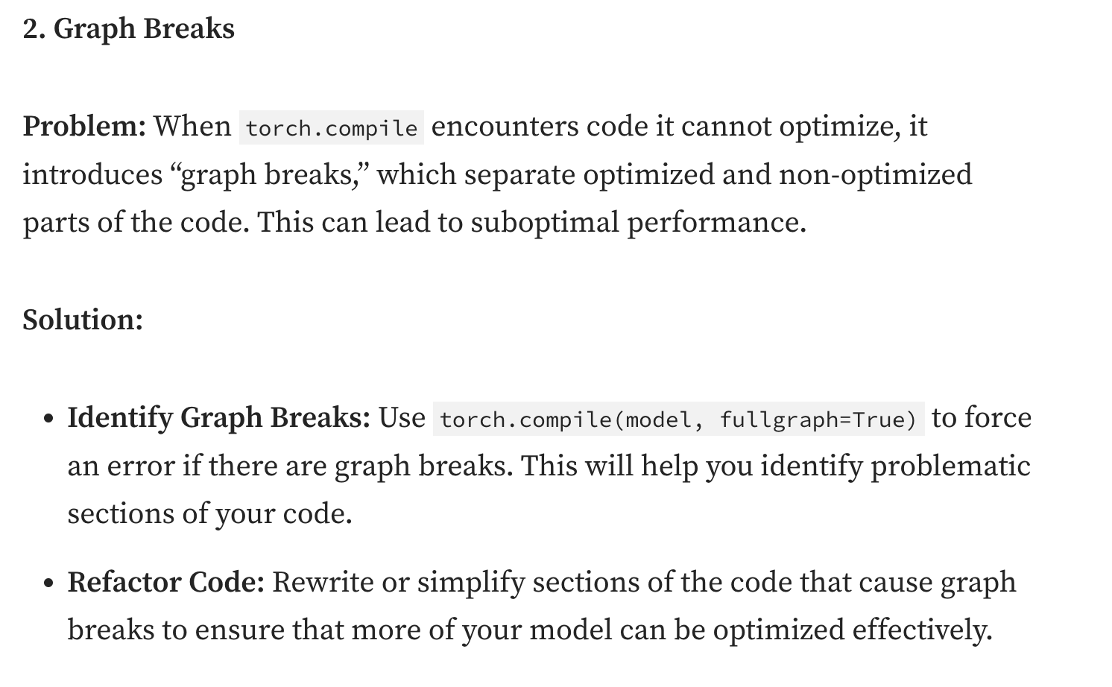
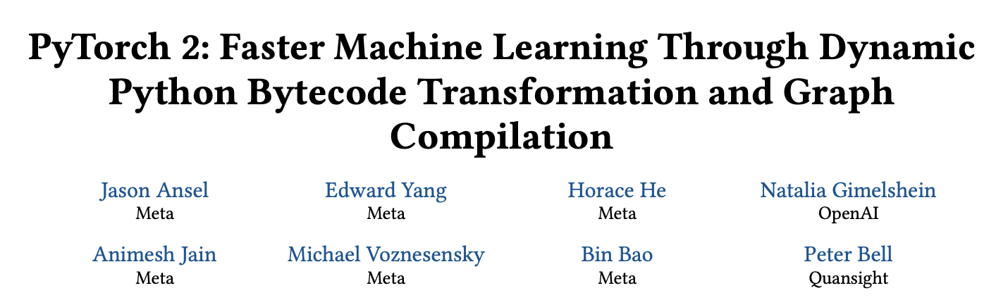
Background Work
The PyTorch 2 paper introduced a new torch.compile feature that enabled graph compilation in PyTorch programs
However, a prominent issue is that of graph breaks
The current explain functionalities are very obtuse, different graph breaks are not classified precisely, and there is a current lack of research in making these results more understandable (and providing the associated solutions)

Slide 5
Technical Challenges
There seemed to be an absence of extensive documentation on graph breaks (e.g. a lack of real-life examples/scenarios)
So we aimed to create a taxonomy of them
Analysis of graph breaks: from PyTorch’s provided explanations, can we extract/parse meaningful data and abstract it to a higher, more understandable level?
LLM integration: can we structure the provided feedback in a manner so that an LLM can easily take it and return accurate, actionable information?
Performance: we want the tool to be lightweight and easy-to-use, and provide response in a short amount of time
UI: we want an intuitive interface for users to improve easability

Slide 6
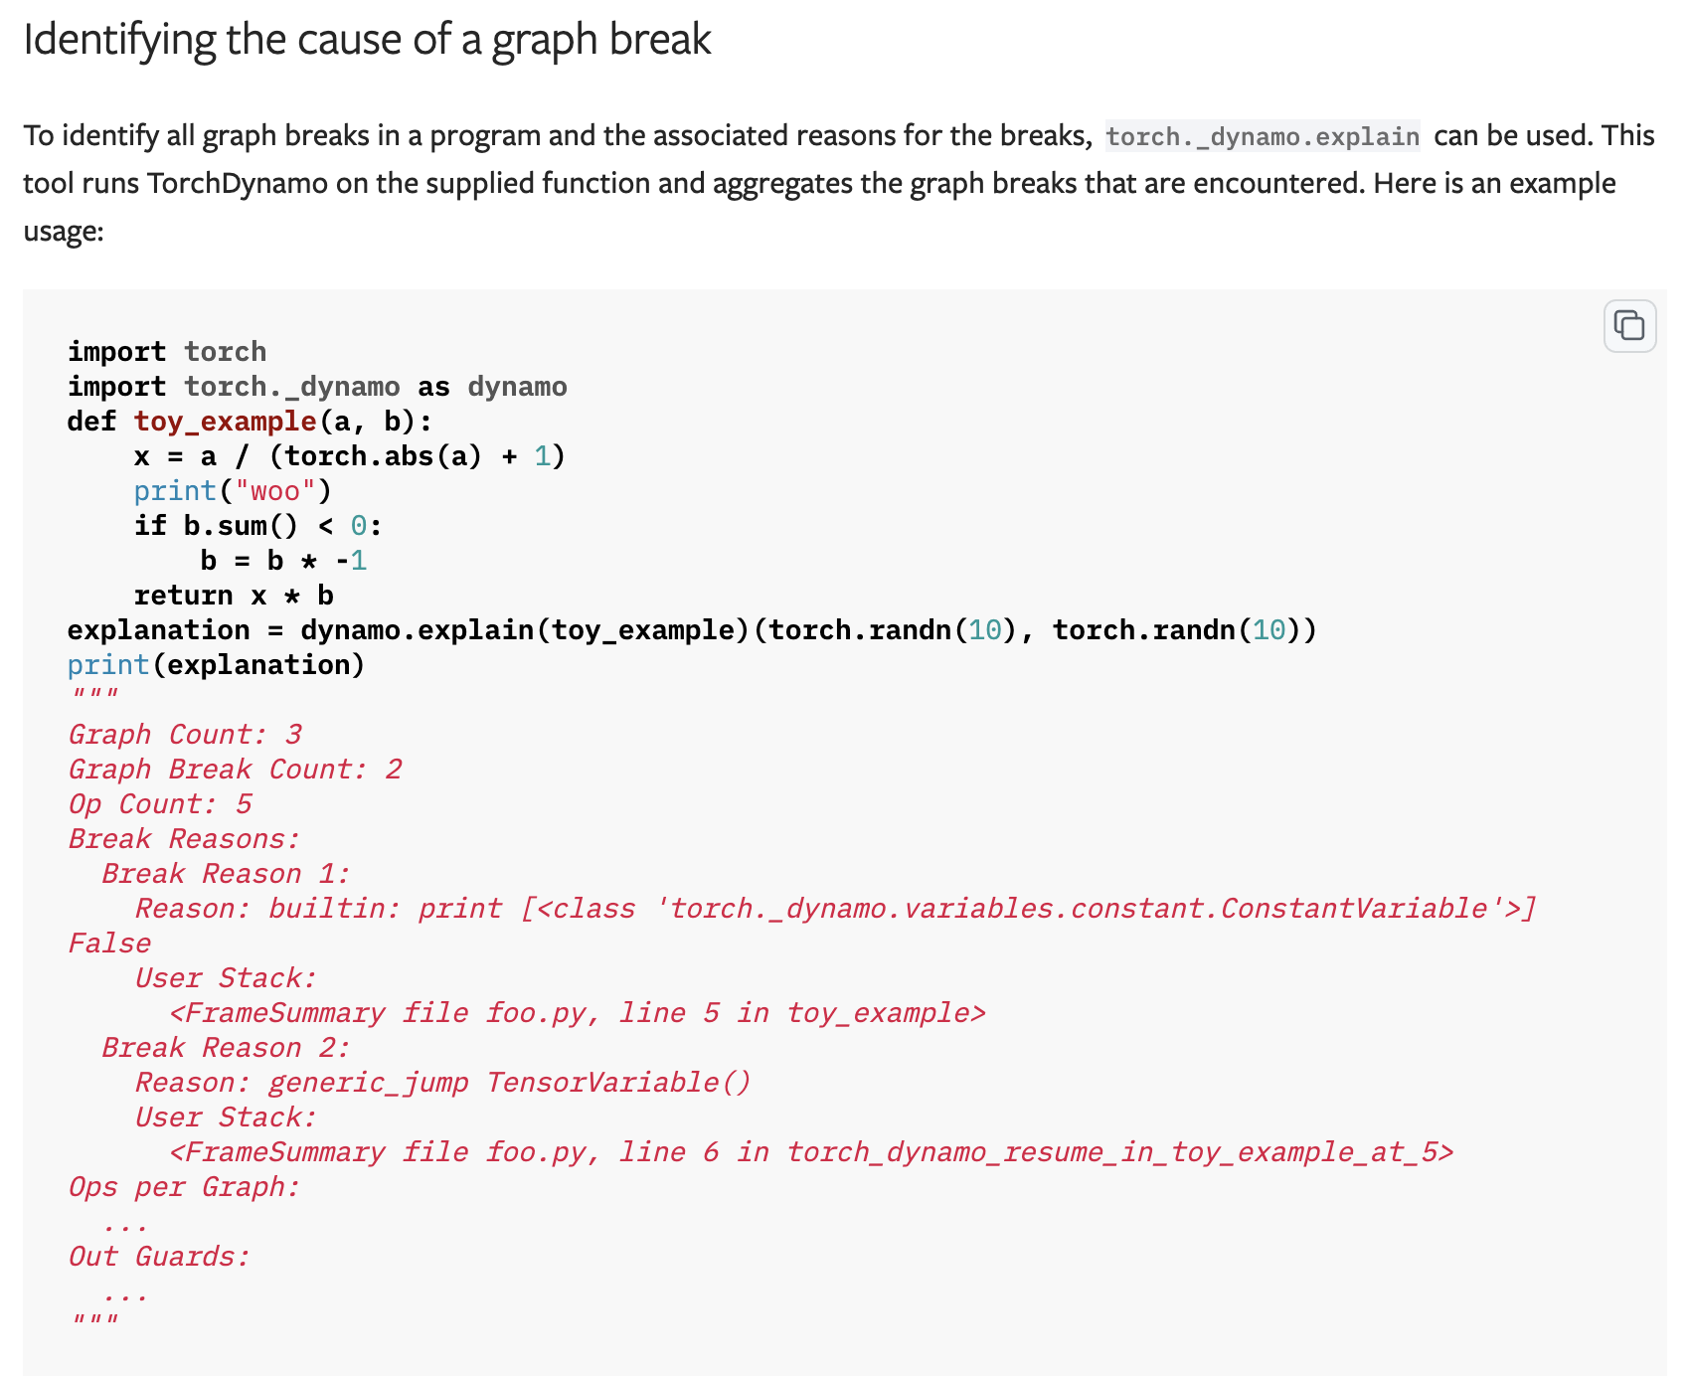
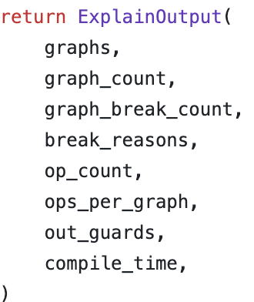
torch._dynamo.explain()
From https://pytorch.org/docs/stable/torch.compiler_faq.html
https://github.com/pytorch/pytorch/blob/6178be822dc3fb307e950c337876f05dd63582b2/torch/_dynamo/eval_frame.py#L922

Slide 7
Approach
We developed several functions that leverage torch._dynamo.explain()
Feed in a model and an input, obtain and store the explanation result
Extract useful information such as the number of breaks, where do they occur, and why they occur
We conducted some research scraping through Hugging Face models to see the existing state of graph breaks “out in the wild”
We also tried adapting an LLM to help explain/simplify the information from explain()
Considered fine-tuning and prompt engineering to produce high-quality results
Prompt engineering and few-shot prompting seemed like a straightforward approach to initially experiment on
With more labeled data on graph breaks (from the Hugging Face scrape, for example) we can then consider spending the resources to fine-tune an LLM for this particular task

Slide 8
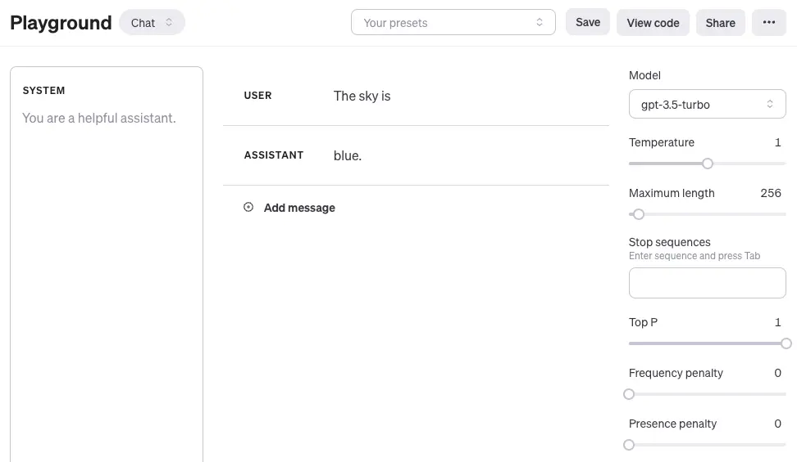
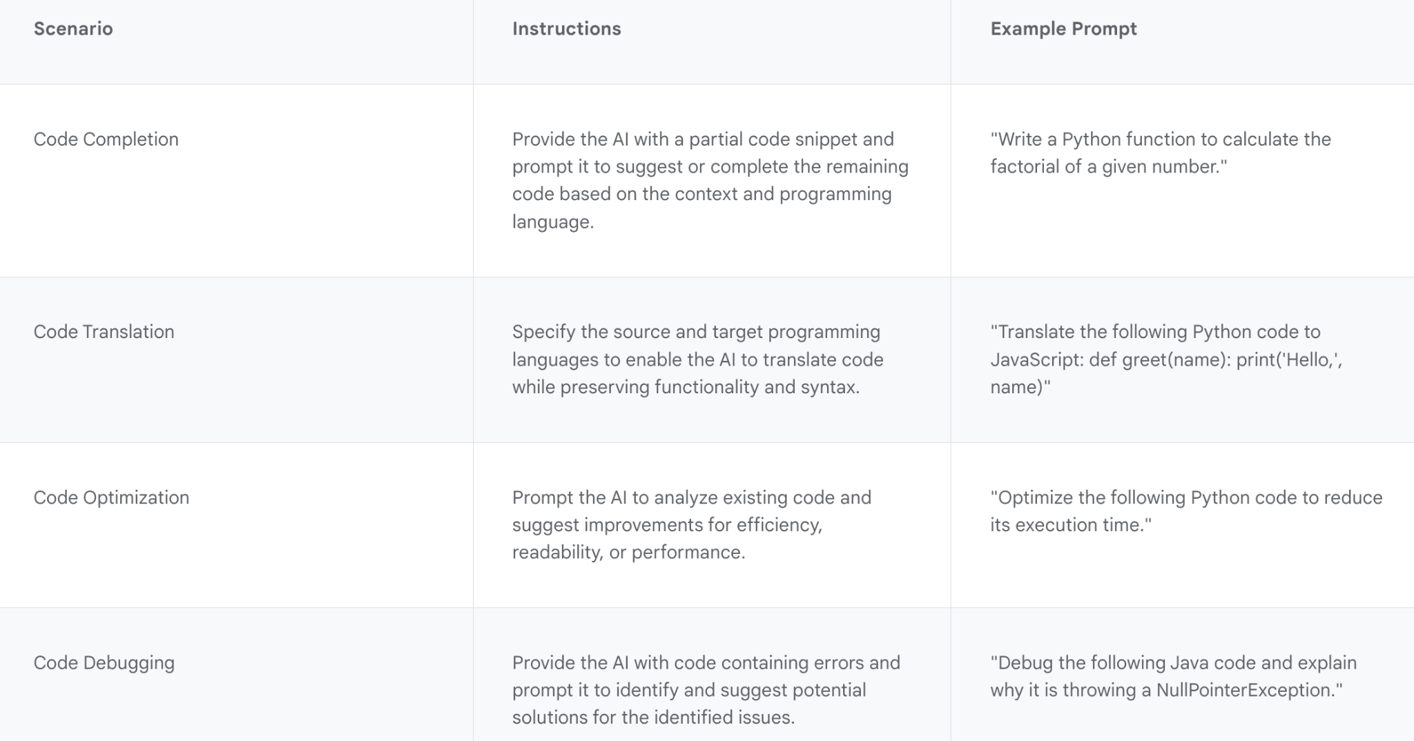
Approach
Creating the taxonomy
Adapting an LLM through prompt engineering:
Referred to several resources: (link 1, link 2, link 3, link 4, link 5)
Prompt engineering is an iterative process
Need to provide context
Zero-shot, few-shot prompting
Need to clearly guide/format the LLM
Chain-of-thought prompting
More advanced techniques:
Tree of thoughts
Generalized CoT
RAG
Access external knowledge
Prevent hallucinations
Automatic Prompt Engineer
Automated prompt selection
Created a script that utilizes the Gemini API
Also looked into fine-tuning options:
Bottleneck: necessary training data to fine-tune with
Google Gemini (link 1, link 2)
OpenAI (link)

Slide 9
Solution Diagram/Architecture
Graph Break Data
(to fine-tune model)
Information sent to debugger:
Relevant code
torch._dynamo.explain() output
Has graph break
User
Graph Break Debugger
Returns simple explanation, solution

Slide 10
Implementation Details
See Github repo: https://github.com/haiyu-wei/HPML_Project
We currently have a function that takes the output from torch._dynamo.explain() and then parses through to get relevant graph break information
For the LLM, we are currently using the Gemini API due to past experience/knowledge
But we are also considering using the OpenAI API as well (along with other possible choices), especially to compare performance and results

Slide 11
Demo/Experiment Design Flow
In the demo, we will go over the methods we have implemented for leveraging torch._dynamo.explain() and the Gemini API
We will then apply it to the OFA-Sys/small-stable-diffusion-v0 model and see what the explanation output looks like with regards to graph breaks

Slide 12
Demo
Notebook: https://colab.research.google.com/drive/1dSeiWpQLr14-AWY7AhTbvFOlLSuGDmWG?usp=sharing

Slide 13
Experimental Evaluation
To evaluate our tool’s quality, we would likely need supervision/user-feedback to assess quality
Possible metrics: user rating (1-5) on how useful/clear the feedback was, (if deployed) metrics on productivity improvement (e.g. average time to fix bug, average number of graph break issues faced/resolved, time saved/work done, etc.), cost vs. benefit
In terms of the taxonomy:
Measuring coverage/breadth
Measuring complexity/granularity
Detecting patterns of frequently occurring graph breaks
Measuring performance using synthetic benchmarks

Slide 14
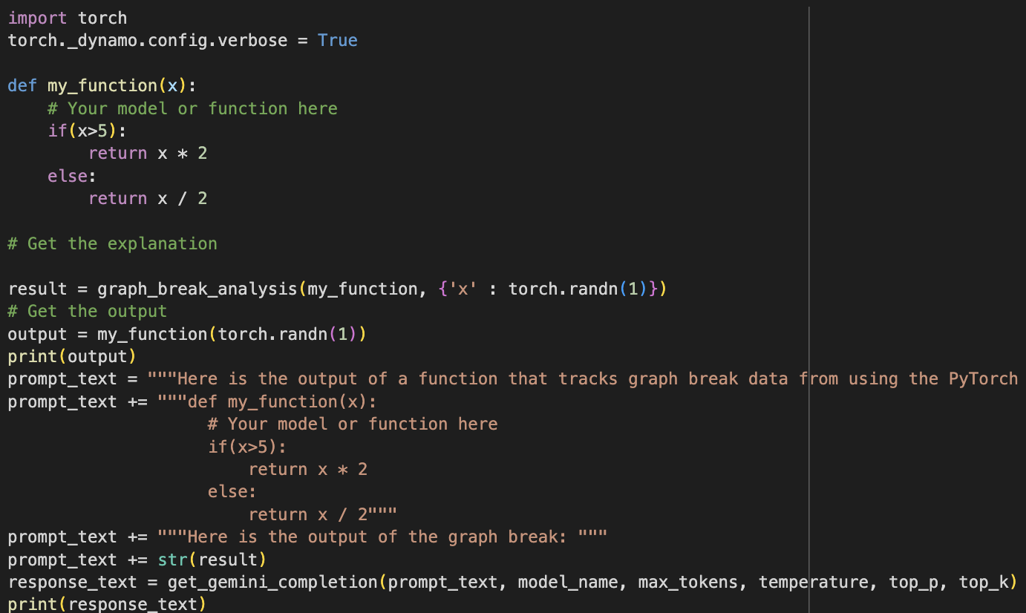
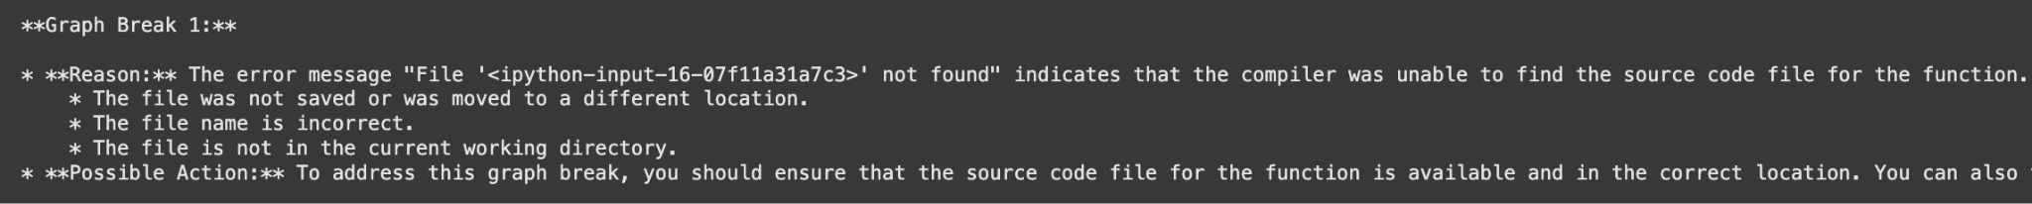
Experimental Evaluation
From a qualitative standpoint:
Promising, but still some issues:
Lack of information from PyTorch: it returned some fallback information, but not any info that could help provide context
Two possible approaches: 1.fine-tune/improve our LLM so it doesn’t rely on this context 2. improve PyTorch functionality to trace through these cases (and provide more context)

Slide 15
Experimental Evaluation
Graph Break Taxonomy:
1. Operation-Based Breaks
2. Dynamic Control Flow & Data-Dependent Branching
3. Integration with External Libraries and I/O
4. Backend / Compiler Configuration-Related Breaks
5. Model-Specific Break Patterns
For more information, please check: graphbreak-taxonomy

Slide 16
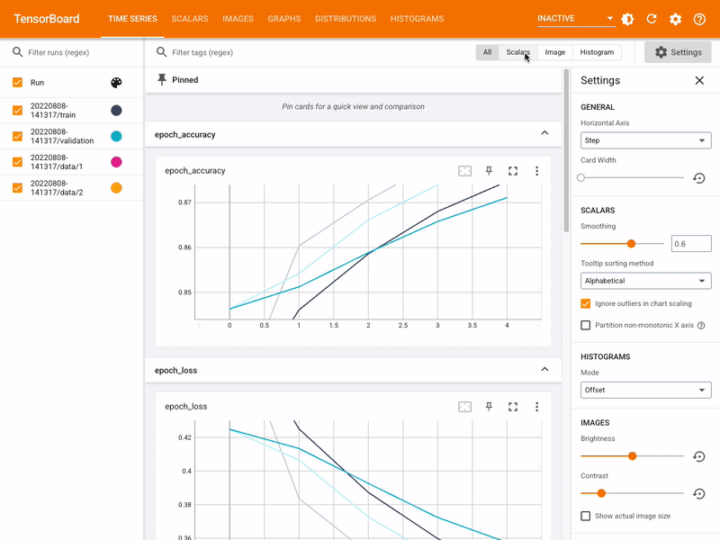
Conclusion
Our tool provides a practical solution for debugging PyTorch graph breaks
Potential for extension to other ML frameworks and error types
Future avenues of exploration:
Get labeled data, use it to fine-tune an LLM for this task
With an extensive taxonomy (e.g. on Hugging Face models), can we create a comprehensive mapping/documentation of graph break scenarios to possible fixes?
UI design: can we create something similar to TensorBoard to help visualize graph breaks and their associated metrics/information?
Improve PyTorch mechanisms to explain graph breaks

Slide 17
Teamwork
Patrick Yeh created the project proposal, presentation, and Project Update slides. He also attended Project Update meetings and took/communicated notes for those meetings. He worked on developing a script using the LLM and prompt engineering/few-shot prompting over the explanation() results
Haiyu Wei figured out how torch._dynamo.explain works. Developed the tool for extract the reasons and location from the process of compilation. Developed the tool for visualize the fx.graph and provide the interface for the input of the LLMs. Fine-tune the result of dynamo.explain output. Tested torch.compile and the developed graph detection tools on models on HuggingFace.
Zhengfei Gong attended weekly meetings to communicate design ideas with supervisors and provide feedbacks to the team. He dived deep into the source code of pytorch to analyze and understand torch._dynamo.explain, _explain_graph_detail and troch.fx.GraphModule. He is working on testing more models to obtain more graph break samples, trying to fine-tune graph break result, evaluating output quality and designing a simple GUI if necessary
We had weekly meetings with each other and our mentors/other groups, and communicated otherwise through Discord and email

